Slide 1
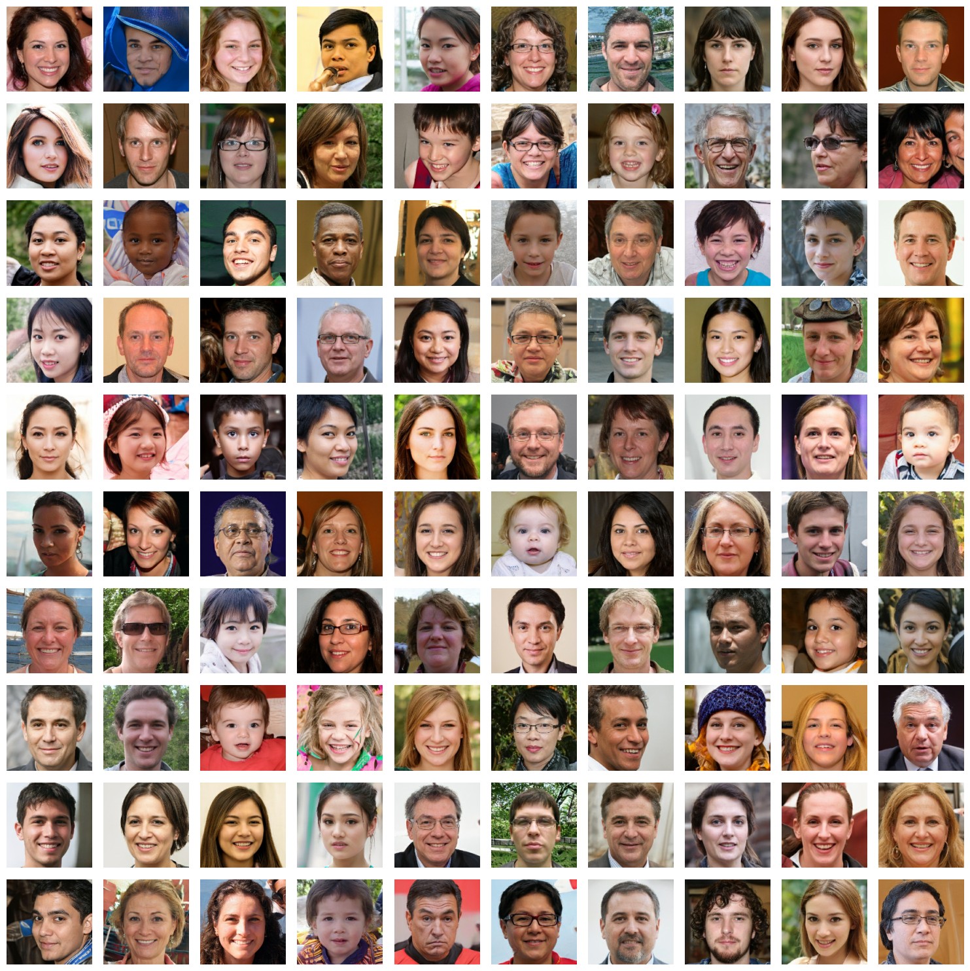
Deep-Fake Face Detection with Machine Learning
Spring 2025
Machine Learning II
Eugene Kim

Slide 2
Why do we need deep-fake face detection?
Deep-fake & diffusion tools pump out photo-real faces in seconds
Scammers use them for fake IDs, romance scams, propaganda posts, etc
Even experts can’t spot good fakes; hand-checking millions of pics won’t work
Goal: build a small CNN that tags real vs fake faces
Notes:
Modern generative models, from StyleGAN to diffusion systems, can create perfectly realistic portraits in seconds. Criminals and influence campaigns already exploit these images—for example, attaching them to forged identity documents, catfishing victims on dating sites, or populating social-media networks with convincing but entirely fictional personas.
The scale of the problem is immense: platforms process millions of profile photos each day, and even trained reviewers cannot reliably separate sophisticated fakes from genuine photos. Manual screening is therefore infeasible.
Our objective is to close this gap with automation. We will build a lightweight convolutional neural network that can distinguish real from fake faces

Slide 3


Dataset Overview
Source: “140 K Real-and-Fake Faces” - Kaggle
- 70 000 genuine portraits (Flickr-Faces-HQ)
- 70 000 synthetic portraits (StyleGAN)
Format: every image resized to 256 × 256 px, RGB
Splits:
- Train: 100 000 (50 K real | 50 K fake)
- Validation: 20 000 (10 K | 10 K)
- Test: 20 000 (10 K | 10 K)
fake
real

Slide 4
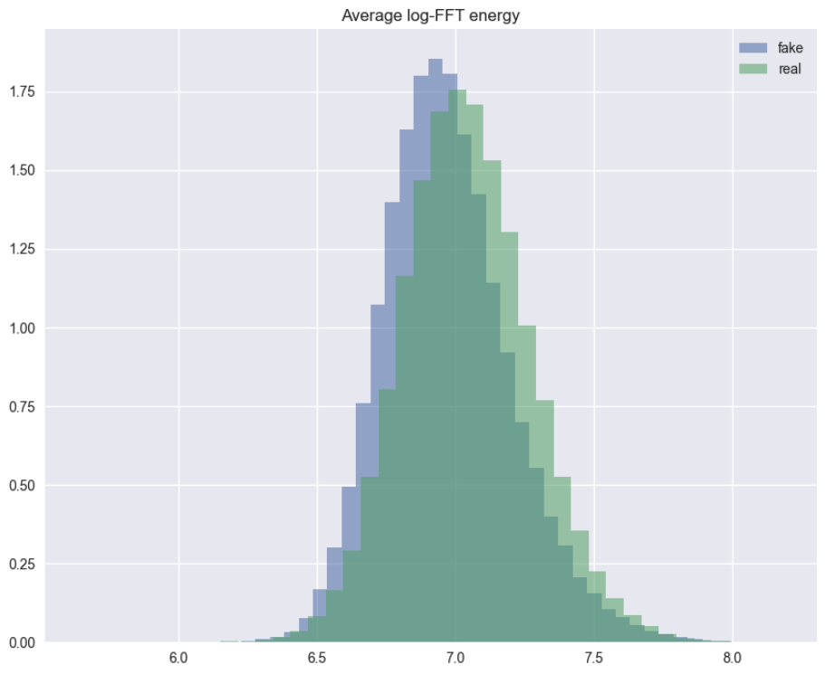
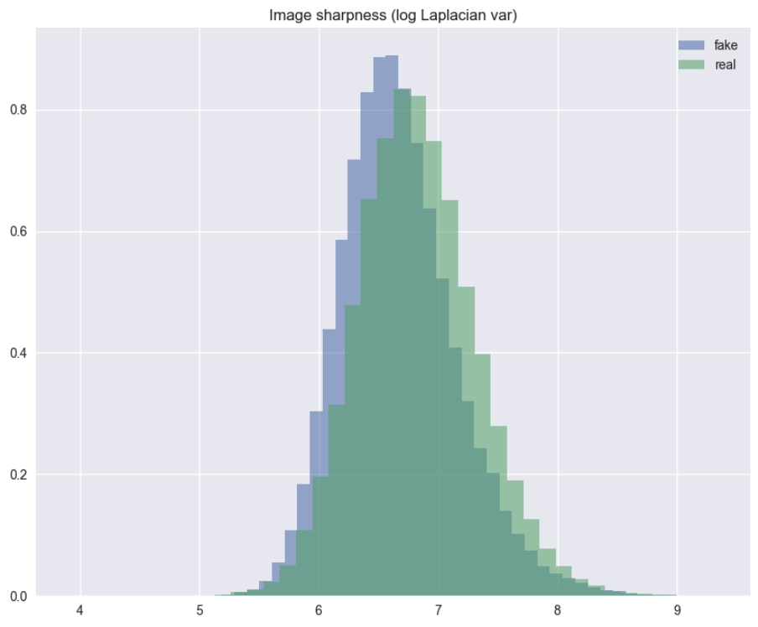
EDA Findings
Sharpness (log Laplacian variance)
- What: variance of edge-strength map
- High: crisp strands & wrinkle edges
- Low: blur / soft focus
Result: real > fake
High-frequency detail (avg log-FFT energy)
- What: average power of fine-scale frequencies
- High: rich pores, stray hairs, grain
- Low: flat, plastic surface
Result: real > fake
Real = sharper & Fake = softer
Notes:
Eugene and Kaushik to connect on this

Slide 5
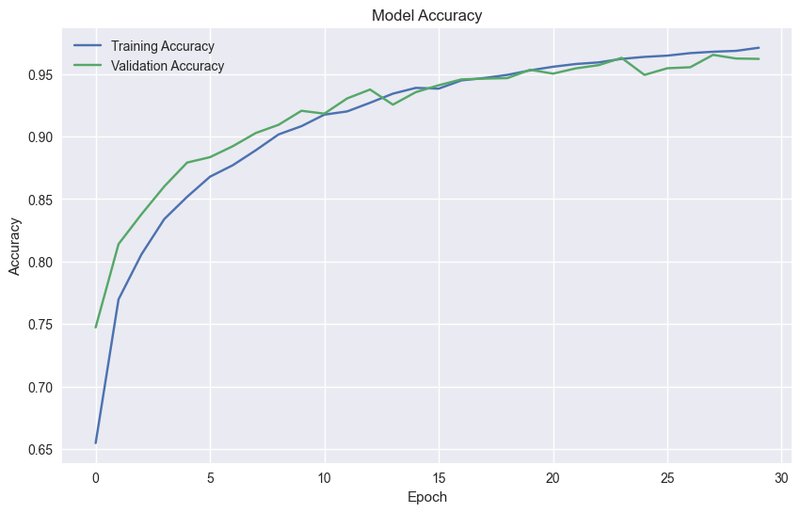
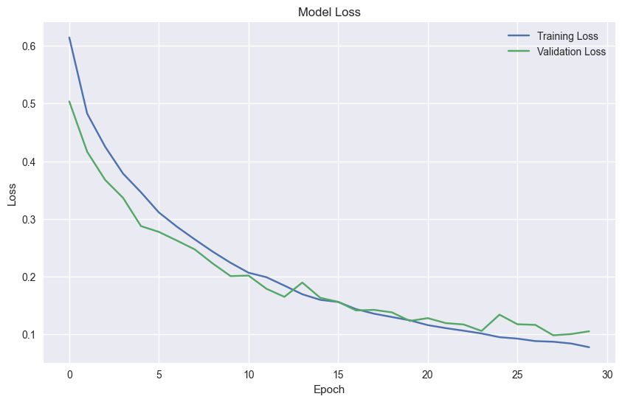
Model & Training
Structure:
3 Conv-Pool blocks (32 → 64 → 128) → Dense 128 + Dropout 0.30 → Sigmoid
Size: 5.4 M weights (≈ 20 MB)
Input & Augment: 160 × 160 RGB │ flip + ±5 ° rotate
Training run: max 30 epochs, early-stop 4 │ ≈ 4 h total
Learning curve: train/val accuracy climbs from 0.65 → 0.96; loss falls smoothly, no over-fit

Slide 6
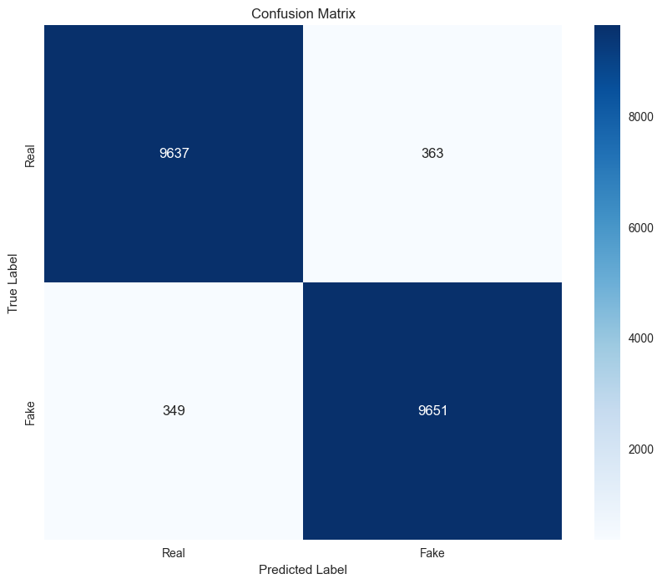
Model Result and Validation
Test accuracy: 96 % on 20 k hold-out images
Precision / Recall: 0.97 (real) 0.96 (fake)
Confusion matrix:
9,637 real faces caught, 363 missed
9,651 fakes caught, 349 missed
Balanced performance across both classes
Notes:
Boosting model- Added stepping for age, downpmt, usage, annual_cost, and also interaction terms
cash , no_use, low_downpmt, heck ,low_age shows top correlation with churn
while high_downpmt, credit_card, direc_debit, mid_use, high_use, is_promo, high_age are top correlation with retention

Slide 7
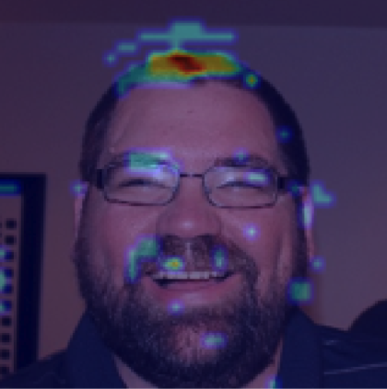
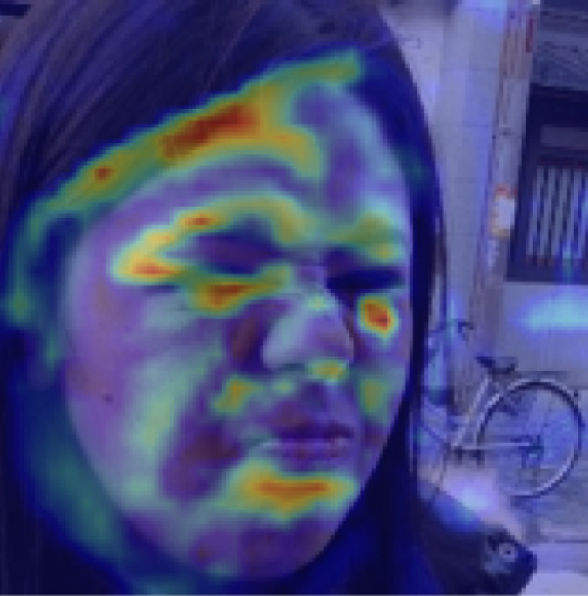
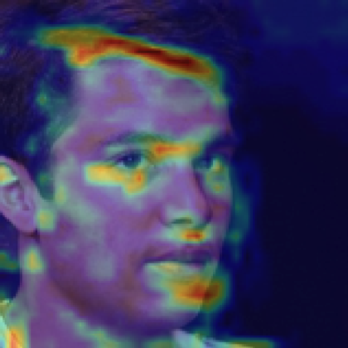
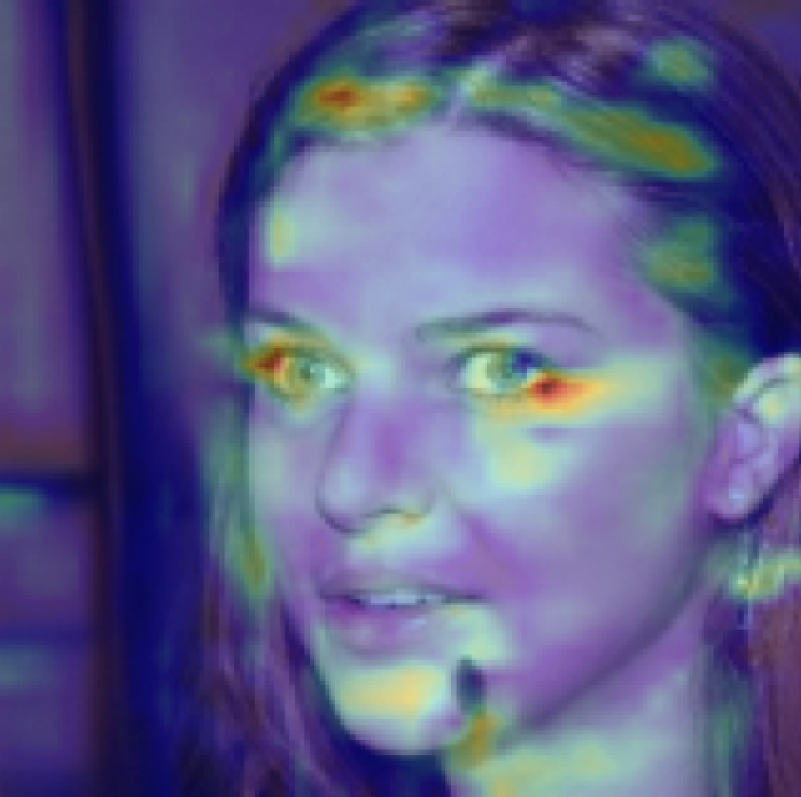
Grad-CAM: Where the Model Looks
Real
- Heat concentrates on hairline / parting, eye corners, lips, wrinkle lines
- These spots hold the finest edges and texture in a face
- Model inspects them for blur or colour seams → main evidence for the decision
- Same regions showed texture loss in sharpness & FFT EDA plots
Fake
Notes:
The cross-validation results show that the accuracy scores ranged from 0.89 to 0.91, with an average score of 0.90 and a standard deviation of 0.01. This small variation suggests that the XGBoost model is consistently performing well across the different folds, providing reliable predictions for the target variable. It highlights that the model is generalizing effectively and not heavily dependent on any particular fold of data.
The classification report shows strong precision and recall for both classes ('Not Default' and 'Default').
For the 'Default' class, the high precision (low false positives) suggests the model is good at correctly identifying true defaulters without over-predicting.
Similarly, high recall means that the model is effectively identifying most of the defaulters (low false negatives).
The F1-score reflects a good balance between precision and recall, demonstrating that the model performs well overall in distinguishing between defaulters and non-defaulters, which is crucial in reducing financial risk.
The ROC curve's area under the curve (AUC) is 0.95, indicating that the model is effective at differentiating between 'Default' and 'Not Default' cases. A higher AUC means that the model has a high true positive rate while maintaining a low false positive rate, which is crucial in the financial context to ensure that potential defaults are not missed while also minimizing unnecessary alarms.

Slide 8

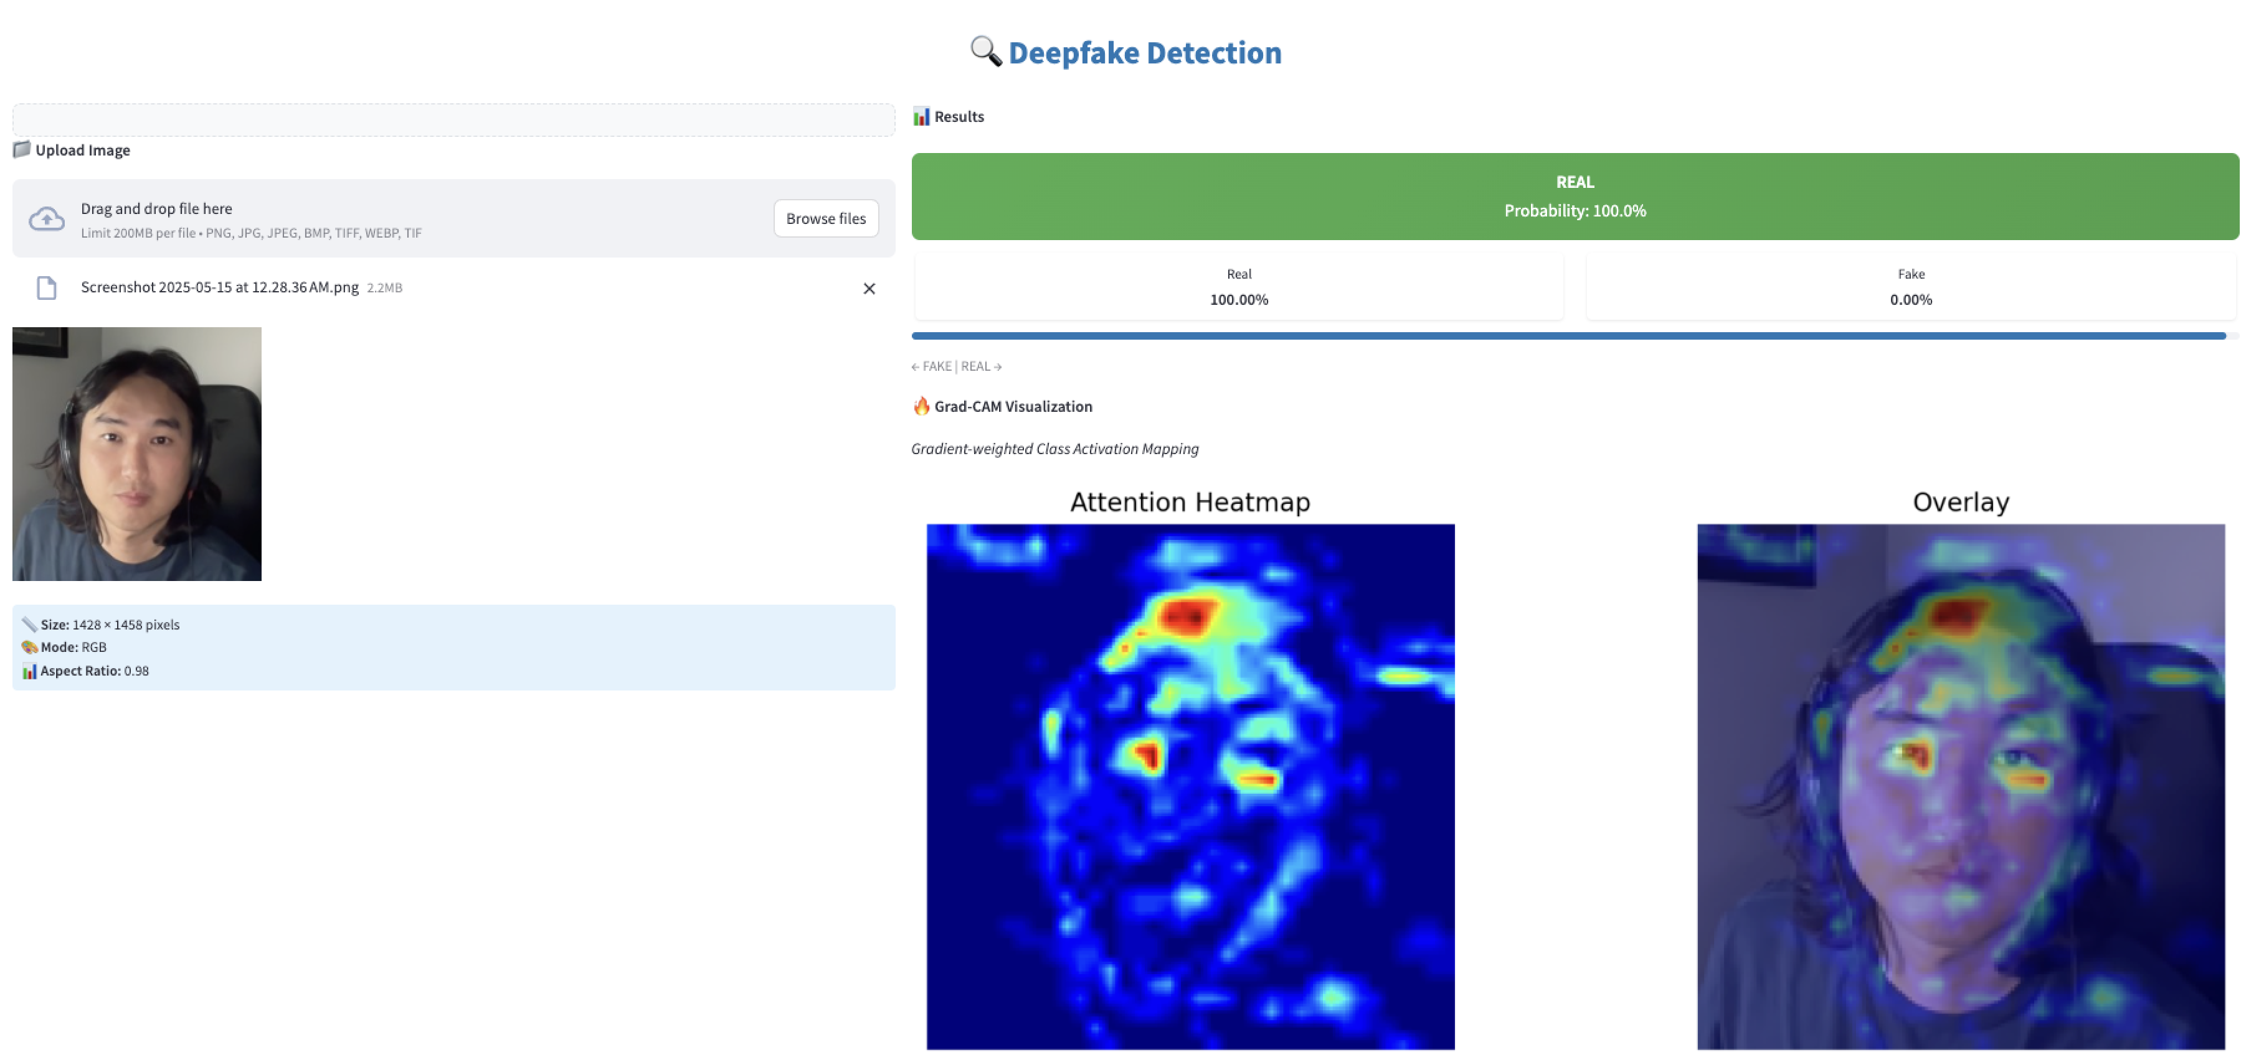
Deployment & Demo

Slide 9
Conclusion & Next Steps
Key results
- Lightweight CNN → 96 % accuracy, 96 % precision, 97 % recall
- Streamlit dashboard turns the model into a drop-in moderation tool
Current limits
- Training fakes = StyleGAN only → diffusion & video deep-fakes still untested
- Newer generators blur less; tiny edge gaps keep shrinking
- Higher-res training needs more powerful GPU & VRAM

Slide 10
Thank you

